Slide 1
OnePose: One-Shot Object Pose Estimation without CAD Models Stage 3 - Deep Dive & Results
Group 3:
Akhilesh Katari
Raghavendra Huliyudurga Mallesha

Slide 2
Introduction
6-D object pose estimation = estimating 3D rotation + translation from RGB images.
Traditional methods rely on CAD models or large category-specific datasets.
OnePose solves CAD-free, category-agnostic pose estimation — only needs one short video.
Key idea: Build a sparse 3D map and directly match 2D→3D using attention
9/12/22
Footer Space
(Slide No.) 2

Slide 3
Overview
OnePose estimates 6D object pose from RGB images without CAD models.
Works for unseen, category-agnostic objects.
Two major stages:
Mapping (Offline): Build 3D map using Structure-from-Motion (CLMAP).
Localization (Online): Match image keypoints to 3D map via a Graph Attention Network (GAT) and estimate pose with PnP + RANSAC
9/12/22
Footer Space
(Slide No.) 3

Slide 4
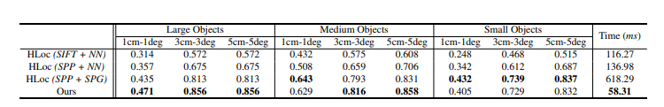
Results
OnePose achieves higher accuracy and is 10× faster.
Attention-based 2D↔3D matching improves speed & robustness.
9/12/22
Footer Space
(Slide No.) 4

Slide 5
Hands-On Implementation
Implemented SuperPoint + SuperGlue in PyTorch (Google Colab.
Objective: Reproduce OnePose’s attention-based matching behavior.
Steps followed:
Load pretrained SuperPoint and SuperGlue models.
Load two test images (synthetic / real).
Detect keypoints and match them.
Visualize matched correspondences.
9/12/22
Footer Space
(Slide No.) 5

Slide 6
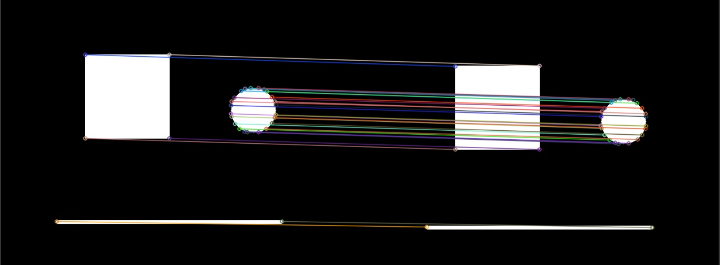
Output Visualization & Results
Output Image: Matched keypoints conncted by colored lines.
“Loaded SuperPoint model / Loaded SuperGlue model (outdoor weights).”
Detected: 33 keypoints (image 1), 34 (image 2)
Valid matches: 29 (~88% accuracy)
Observation: Accuracy drops under rotation or blur.
9/12/22
Footer Space
(Slide No.) 6

Slide 7
Analysis & Connection to OnePose
Our experiment = 2D↔2D attention-based feature matching.
OnePose = extends this to 2D↔3D using a Gaph Attention Network.
Both rely on learned attention to ensure stable correspondences.
Confirms the paper’s claim that attention improves geometric robustness
9/12/22
Footer Space
(Slide No.) 7

Slide 8
Insights & Conclusion
What we achieved:
Read and analyzed the OnePose paper in detail.
Reproduced the feature-matching core using SuperPoint + SuperGlue.
Generated and analyzed visual + quantitative results.
Key Insight:
Attention-based matching is essential for robust, CAD-free pose estimation.
Future Work:
Add COLMAP-based 3D map + PnP solver to estimate actual poses.
9/12/22
Footer Space
(Slide No.) 8

